Slide 1
Duties of the State & Citizens
Key Stage 2

Slide 2
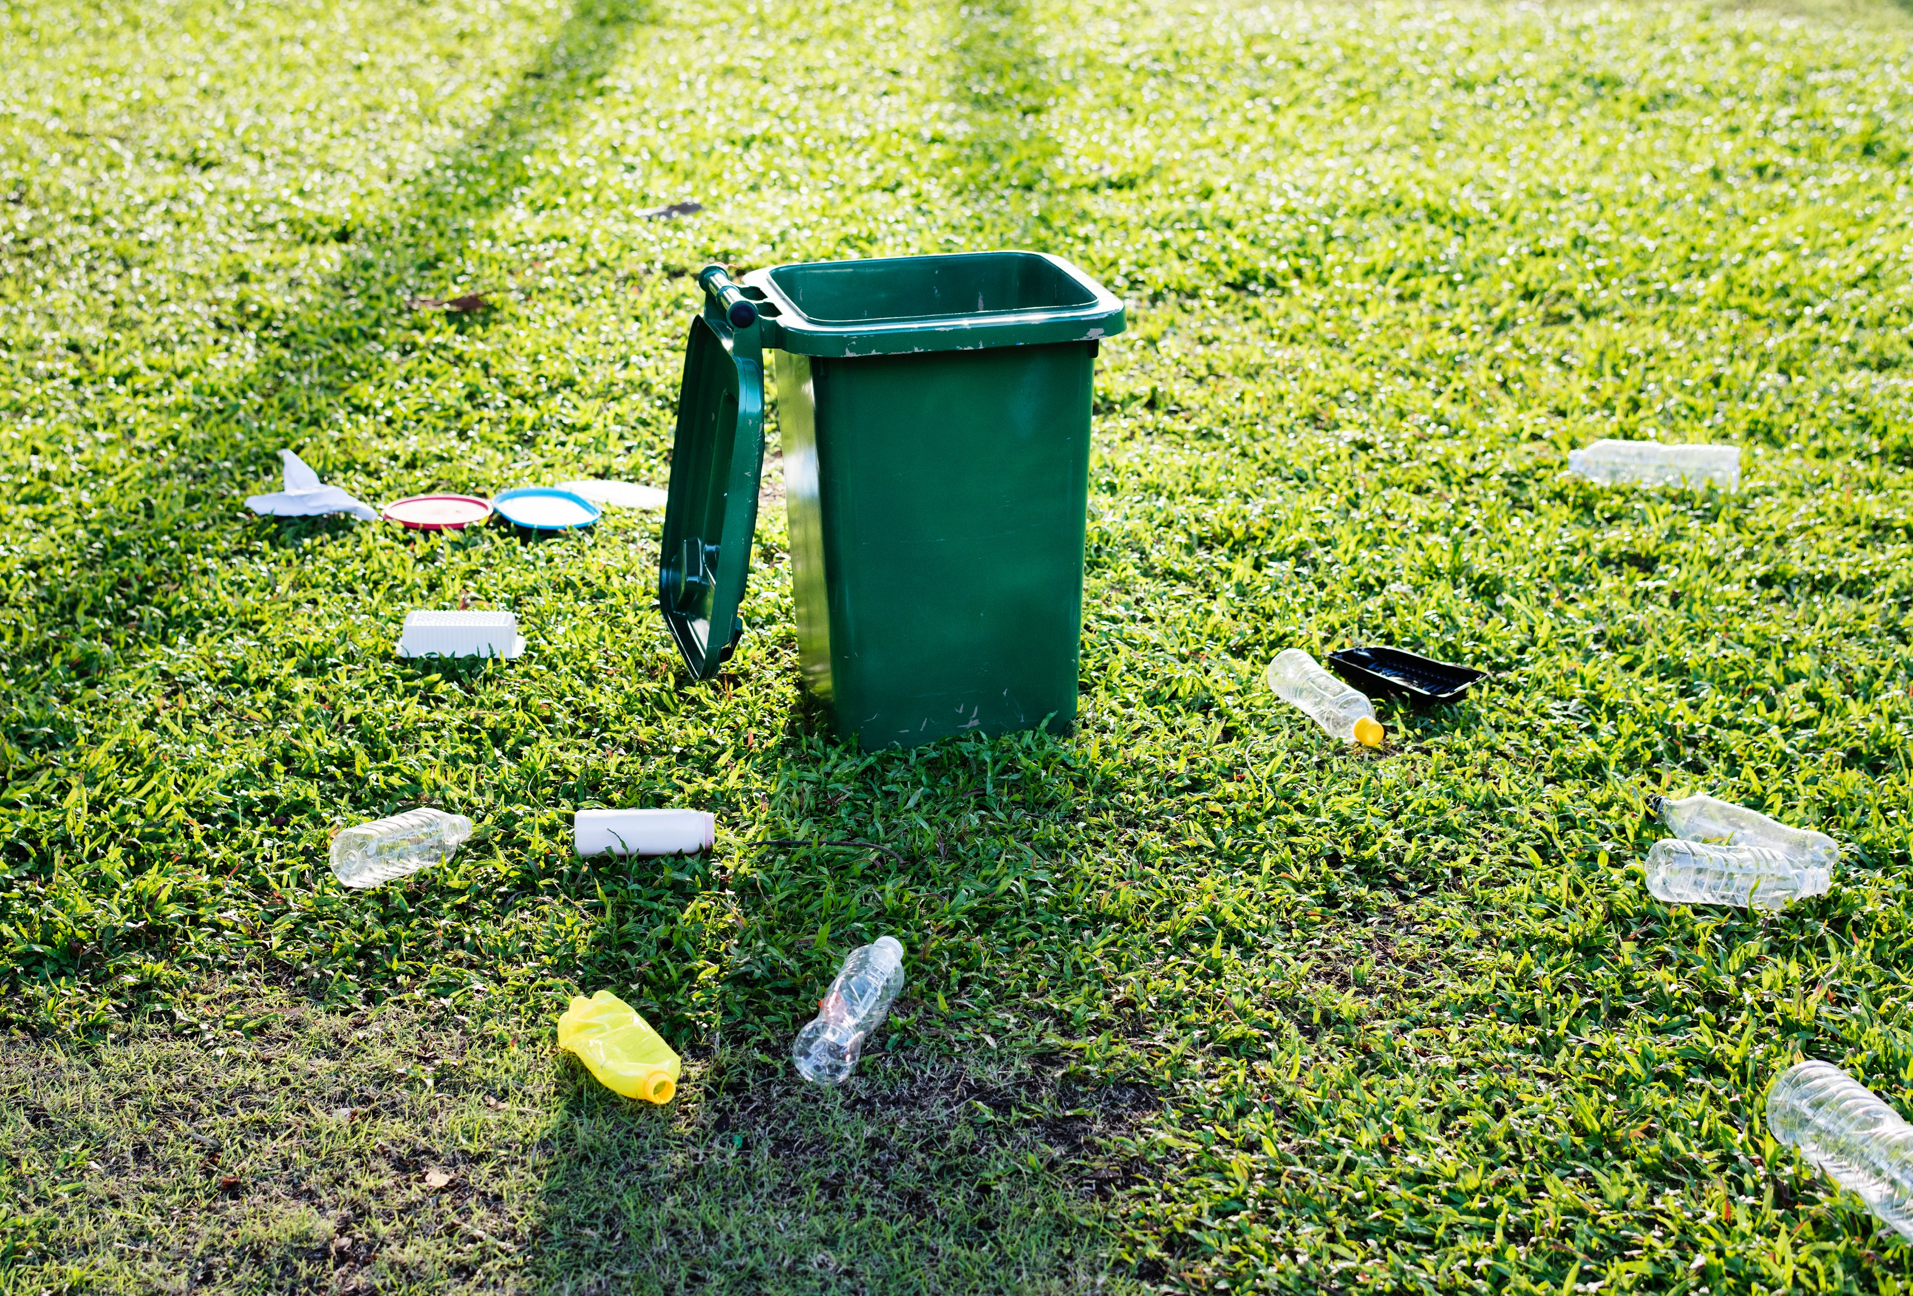
Scenario 1
“Aisha noticed a lot of plastic bottles and trash on the ground during the Company-X fun run. She gathers up every plastic bottle and places it in the recycling bin.”

Slide 3
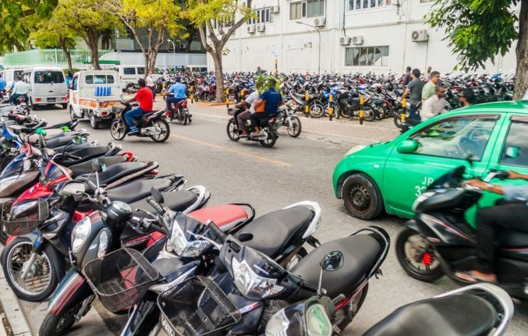
"Ali was talking about his ideas on how to reduce air pollution, but Aala disagreed with him and politely stated why she thought his ideas wouldn't work”
Scenario 2

Slide 4
What is a State?
Who is a Citizen?

Slide 5
The Constitution guides us our duties as State and citizens

Slide 6
Definition: Rights
Rights are basic things everyone deserves to have just because they're human.
They're usually protected by laws or what's considered right in society

Slide 7
Fundamental rights and freedoms
The Constitution of Maldives states the essential rights and freedoms for every citizen.
Notes:
Fundamental rights and freedom are necessary for a nation for the growth of every individual and also for safeguarding peoples’ interests. They are crucial for the government in the sense that they serve as the nation’s backbone. In difficult times, citizens can be protected by their rights.

Slide 8
What are RIGHTS & What are RESPONSIBILITIES?
Notes:
Rights are fundamental entitlements or privileges that individuals possess by virtue of being human.
Responsibilities are things we should do in order to uphold the constitution .

Slide 9
Rights & Responsibility
Rights are freedoms that are protected legally.
Responsibilities are things you should do.

Slide 10
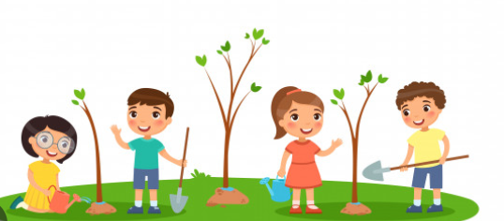
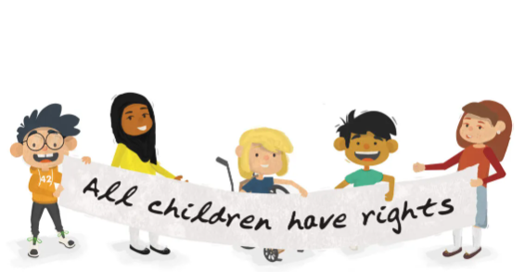
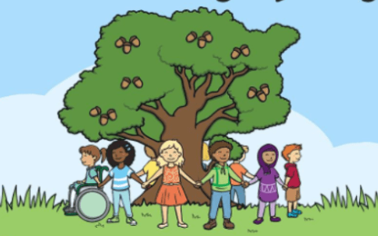
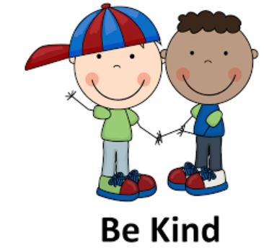
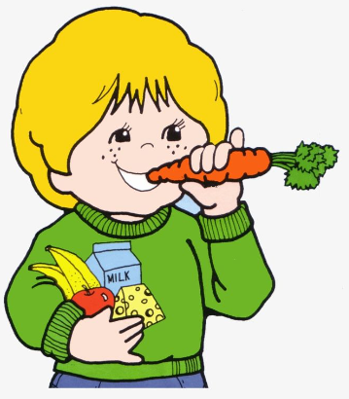
The State & Citizens responsibilities
The responsibilities
State
Citizens
Preserve natural environment,
Uphold rights of others
Contribute to the community's well-being
Ensure equal rights
Provide nutritious food
clean water;
housing healthcare;
Safeguard the State religion of Islam, culture, language, and heritage of the nation
Notes:
right to privacy, right to education, right to vote, freedom of expression, etc.
a healthy environment;
equal access to communication,
media,
transportation, and natural resources
Protect the country's natural environment.
Respect the national flag, state emblem and the national anthem.

Slide 11
Activity

